Slide 1
Lecture4 :
Optimization

Slide 2
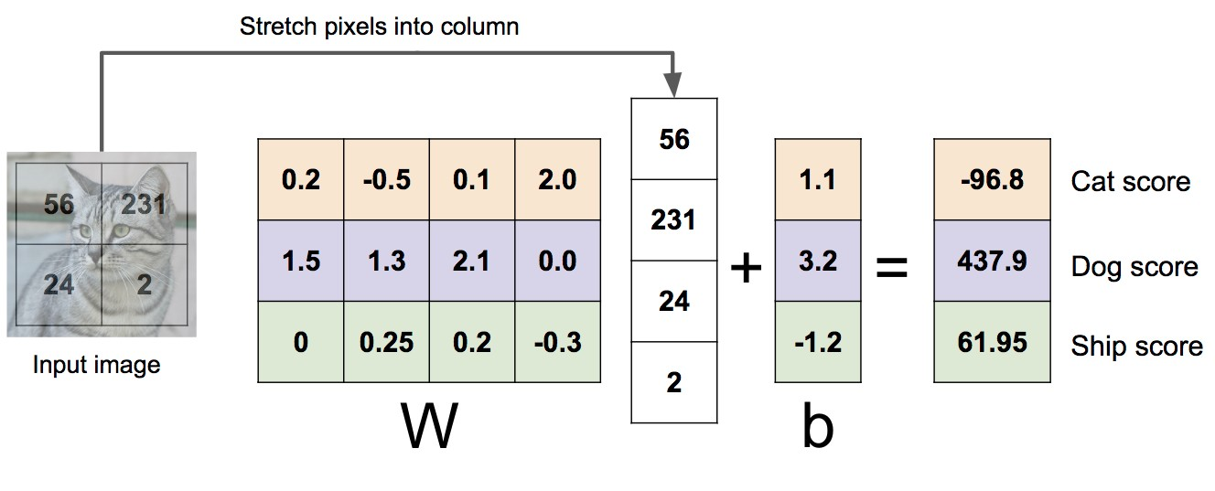
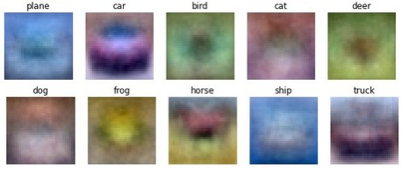
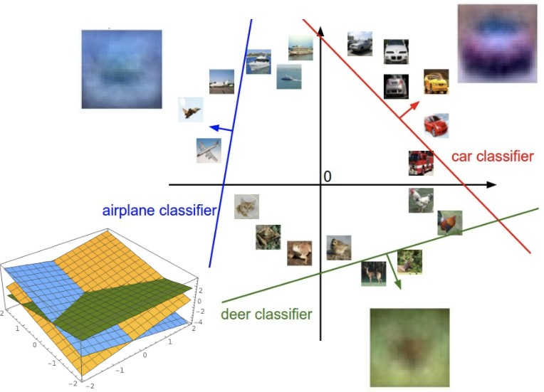
Last Time: Linear Classifiers
Algebraic Viewpoint
Visual Viewpoint
Geometric Viewpoint
f(x,W) = Wx
One template per class
Hyperplanes cutting up space

Slide 3

3

Slide 4
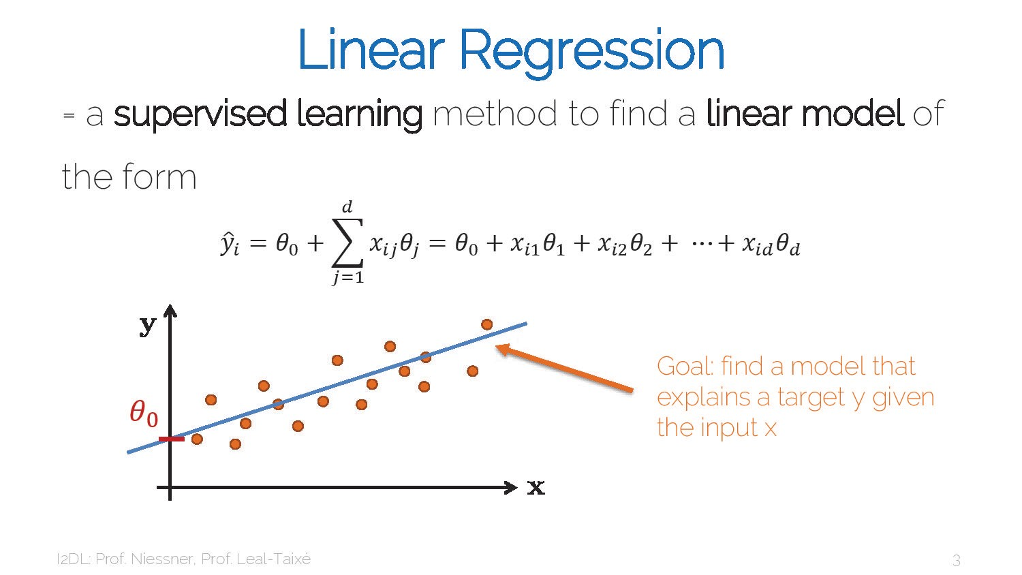
4

Slide 5
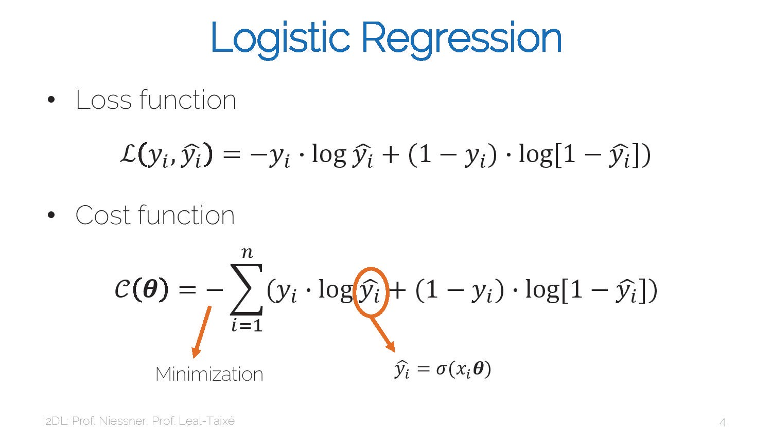
5

Slide 6
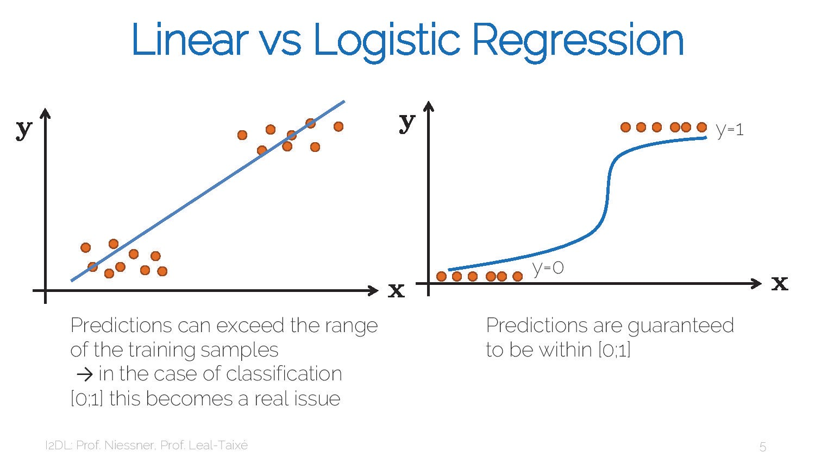
6

Slide 7
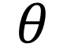
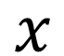
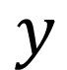
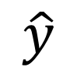
How to obtain Model?
Data points
Labels (ground truth)
$$x$$
$$y$$
L₁
L₂
BCE
SVM loss (hinge loss)
CE (softmax)
Loss
function
Model parameters
Estimation
$$θ$$
$$\hat{y}$$

Slide 8
How to obtain Model?
Data points
$$x$$
Model parameters
Estimation
$$θ$$
$$\hat{y}$$
linear regression
logistic regression
deep learning

Slide 9
How to obtain Model?
least square
MLE
gradient descent
Data points
Labels (ground truth)
$$x$$
$$y$$
Optimization
Loss
function
Model parameters
Estimation
$$θ$$
$$\hat{y}$$

Slide 10
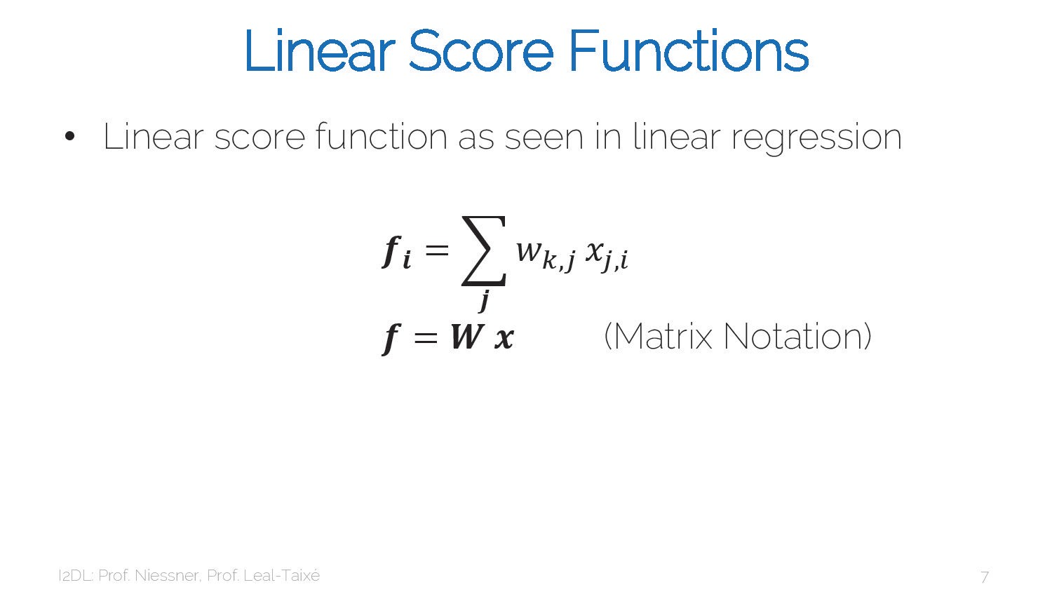
10

Slide 11
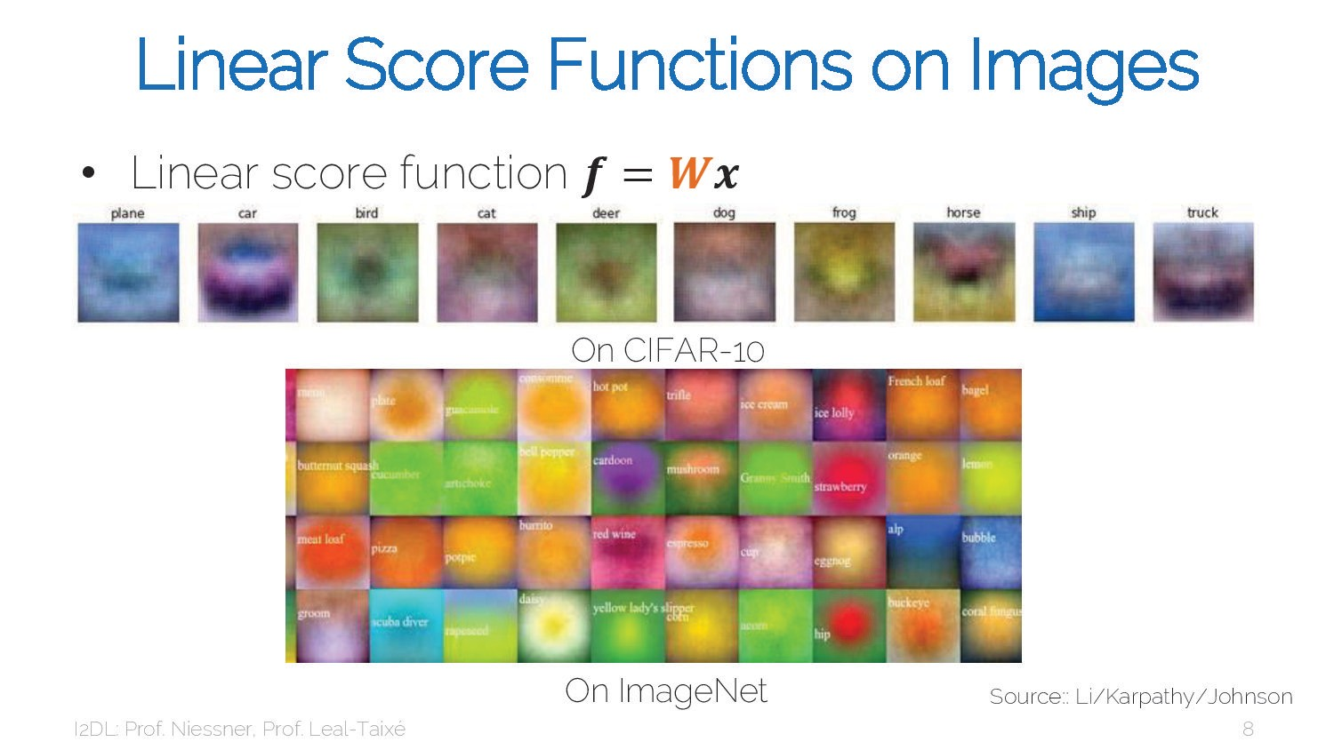
11

Slide 12
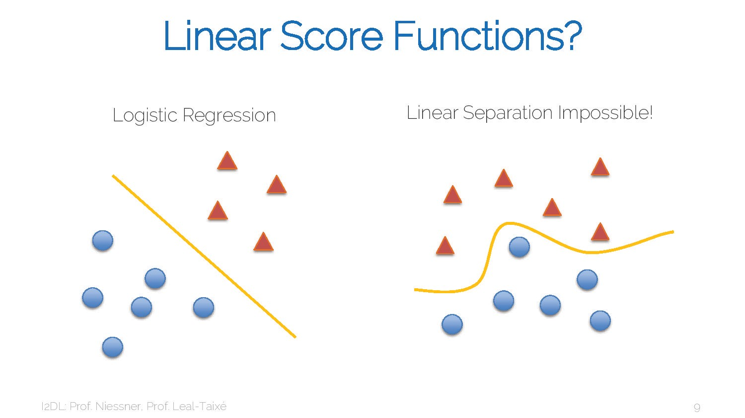
12

Slide 13
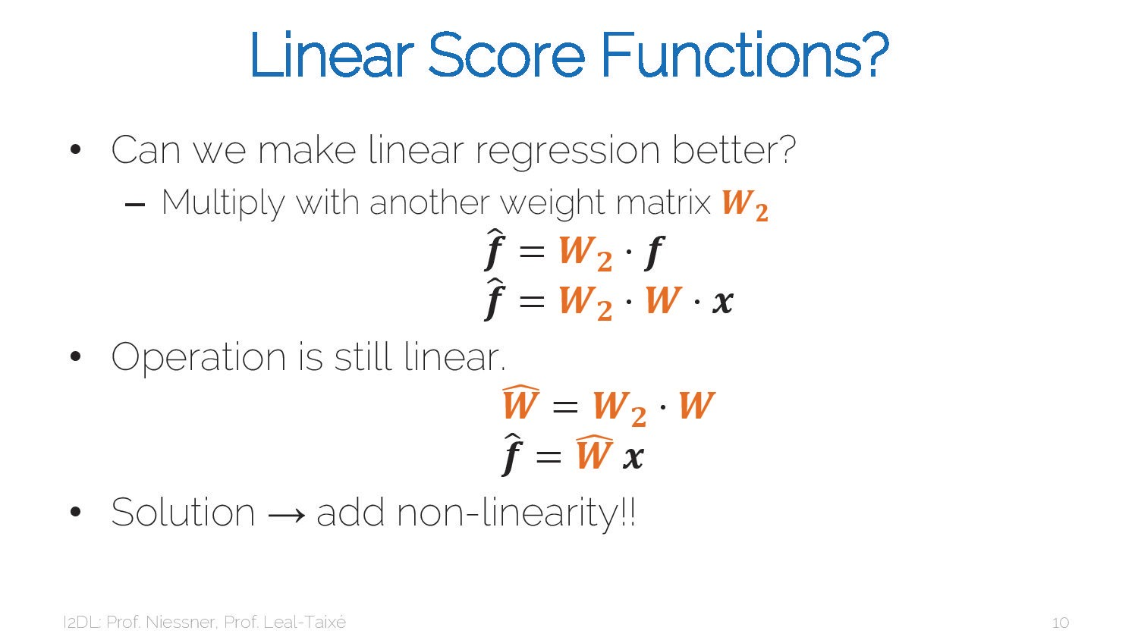
13

Slide 14
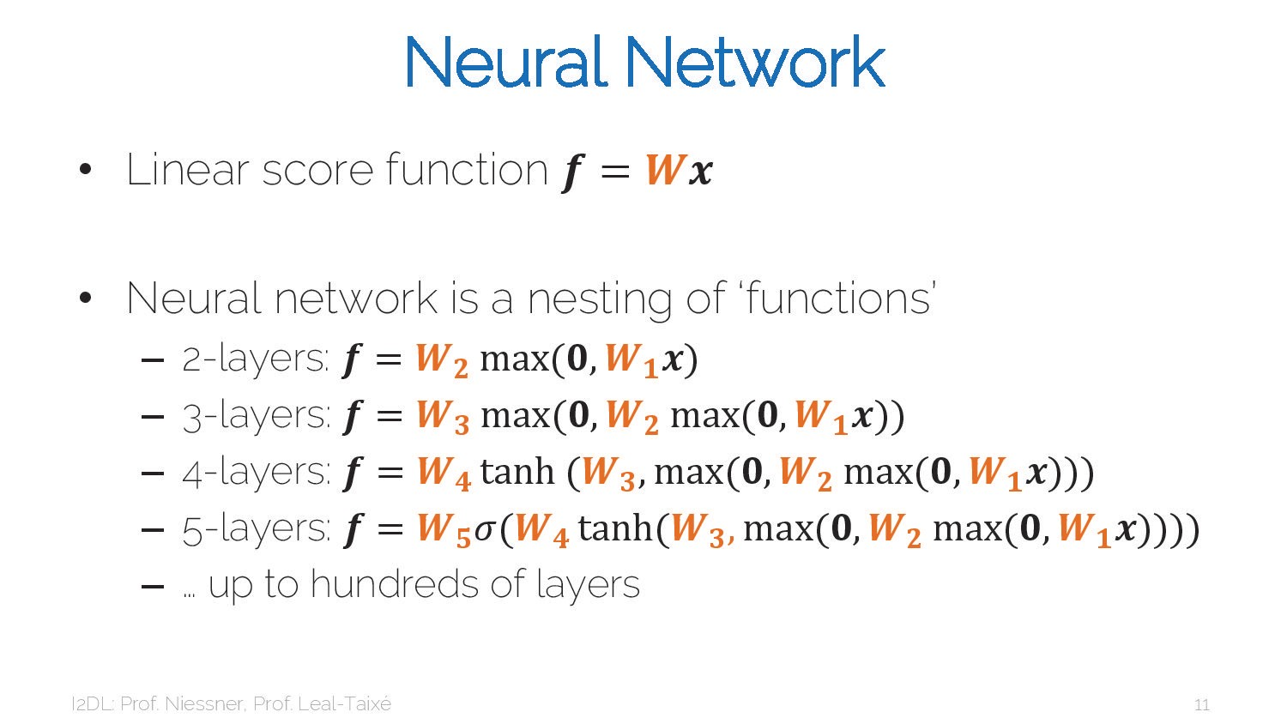
14

Slide 15
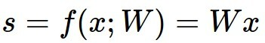
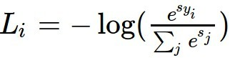
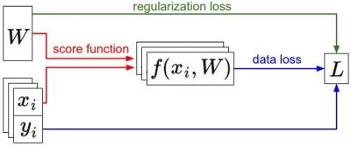
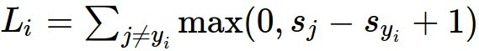
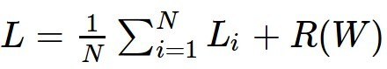
Last Time: Loss Functions quantify preferences
We have some dataset of (x, y)
We have a score function:
We have a loss function:
Softmax
Linear classifier
SVM
Full loss

Slide 16
Last Time: Loss Functions quantify preferences
We have some dataset of (x, y)
We have a score function:
We have a loss function:
Softmax
Q: How do we find the best W?
Linear classifier
SVM
Full loss

Slide 17
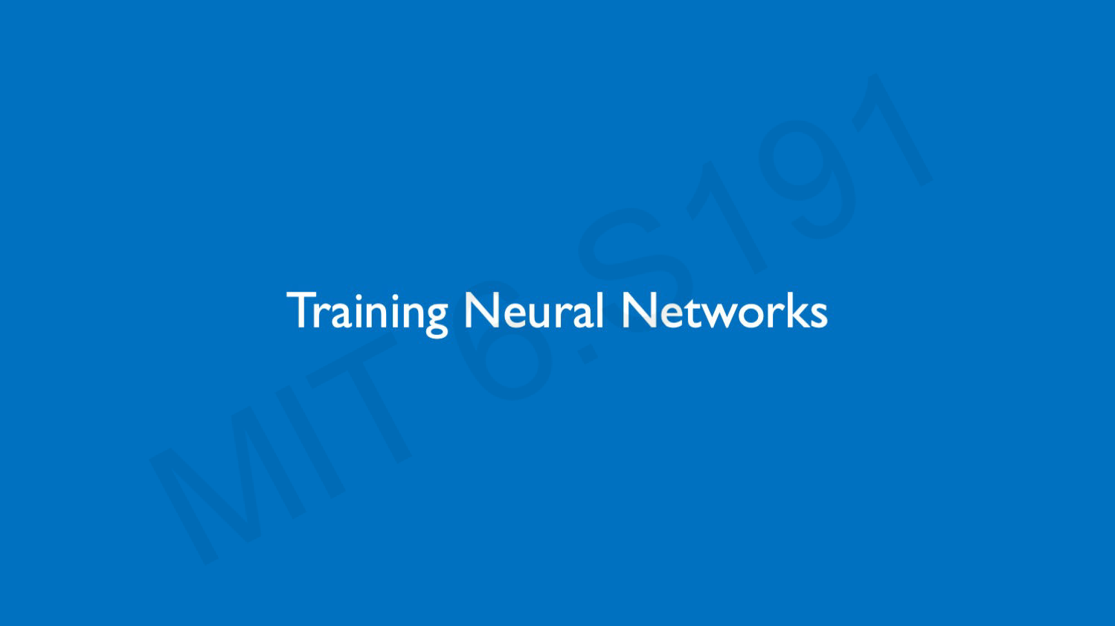
17

Slide 18
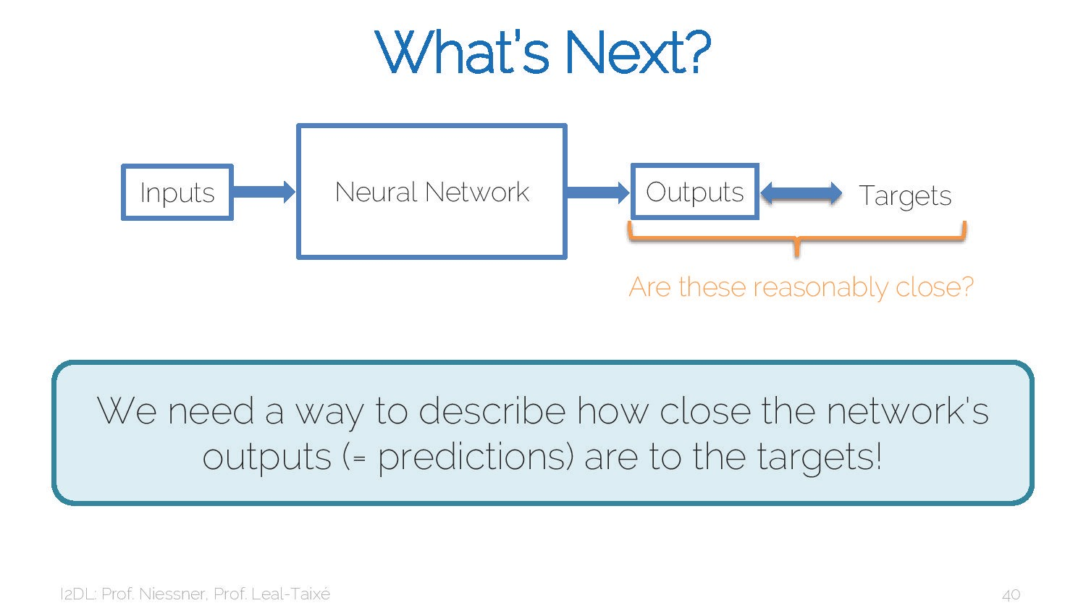
18

Slide 19
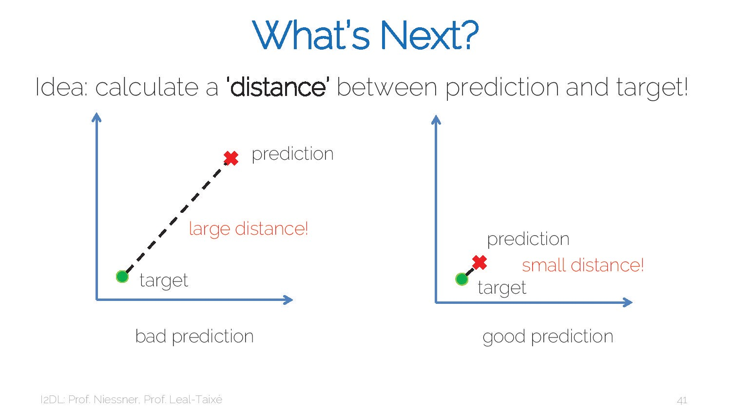
19

Slide 20
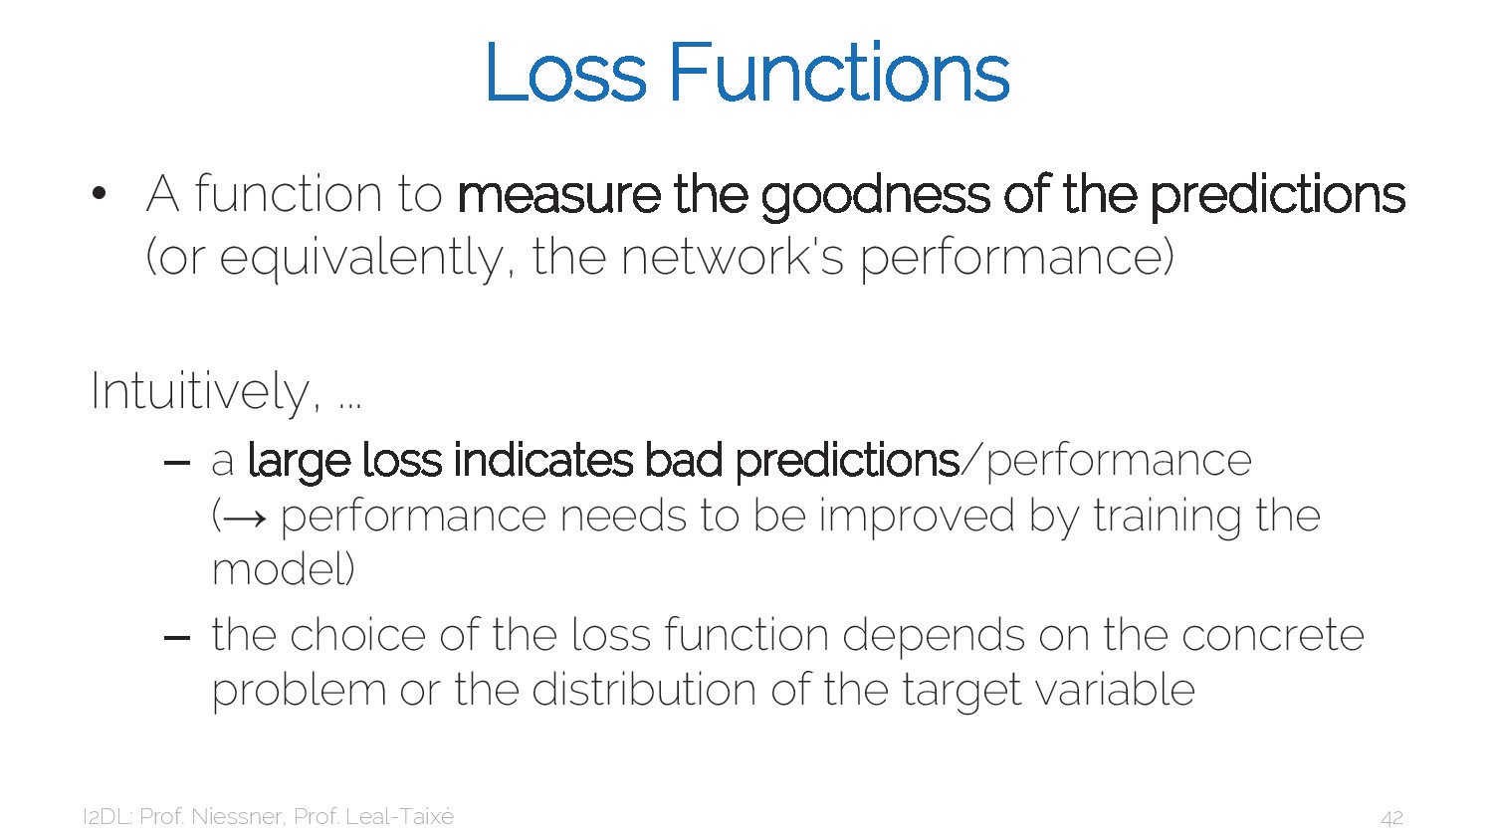
20

Slide 21
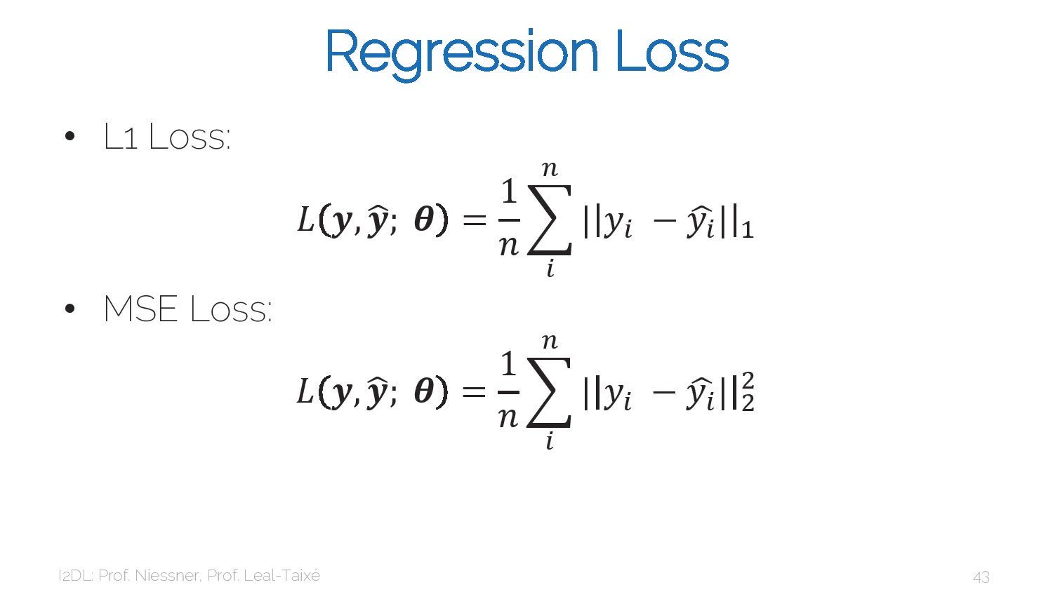
21

Slide 22
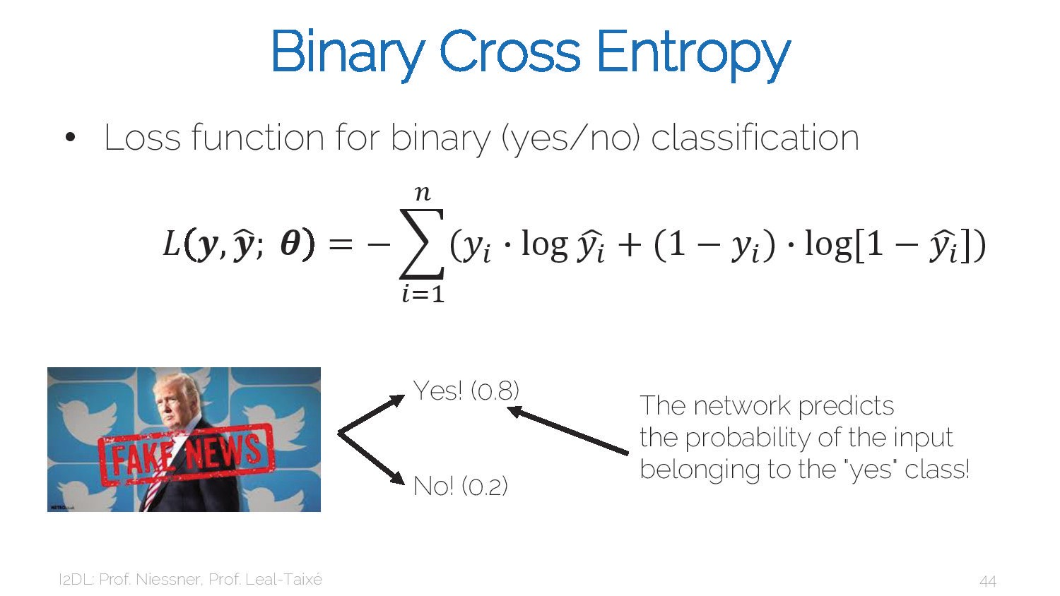
22

Slide 23
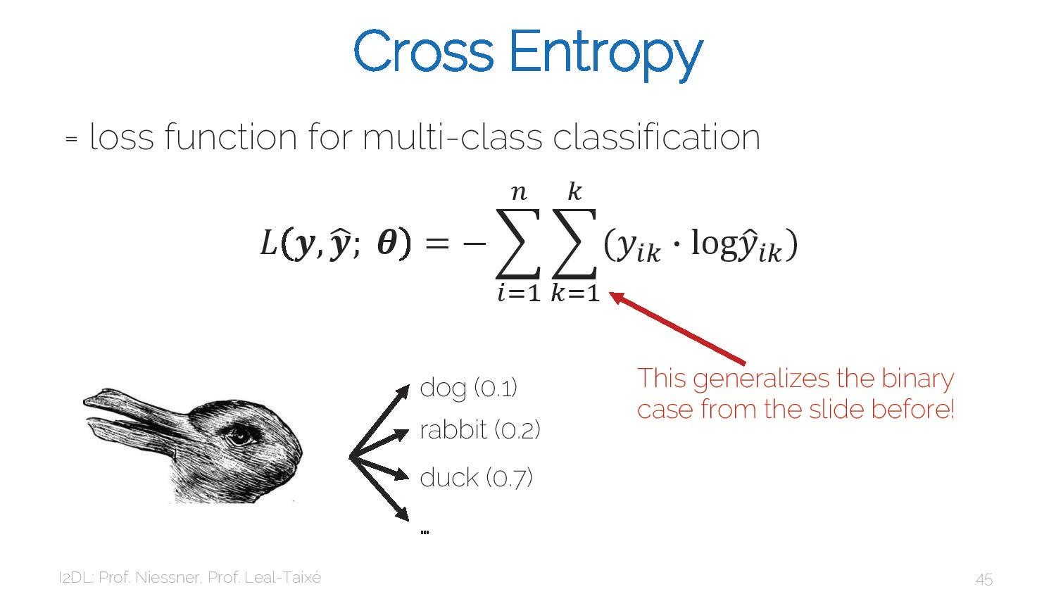
23

Slide 24
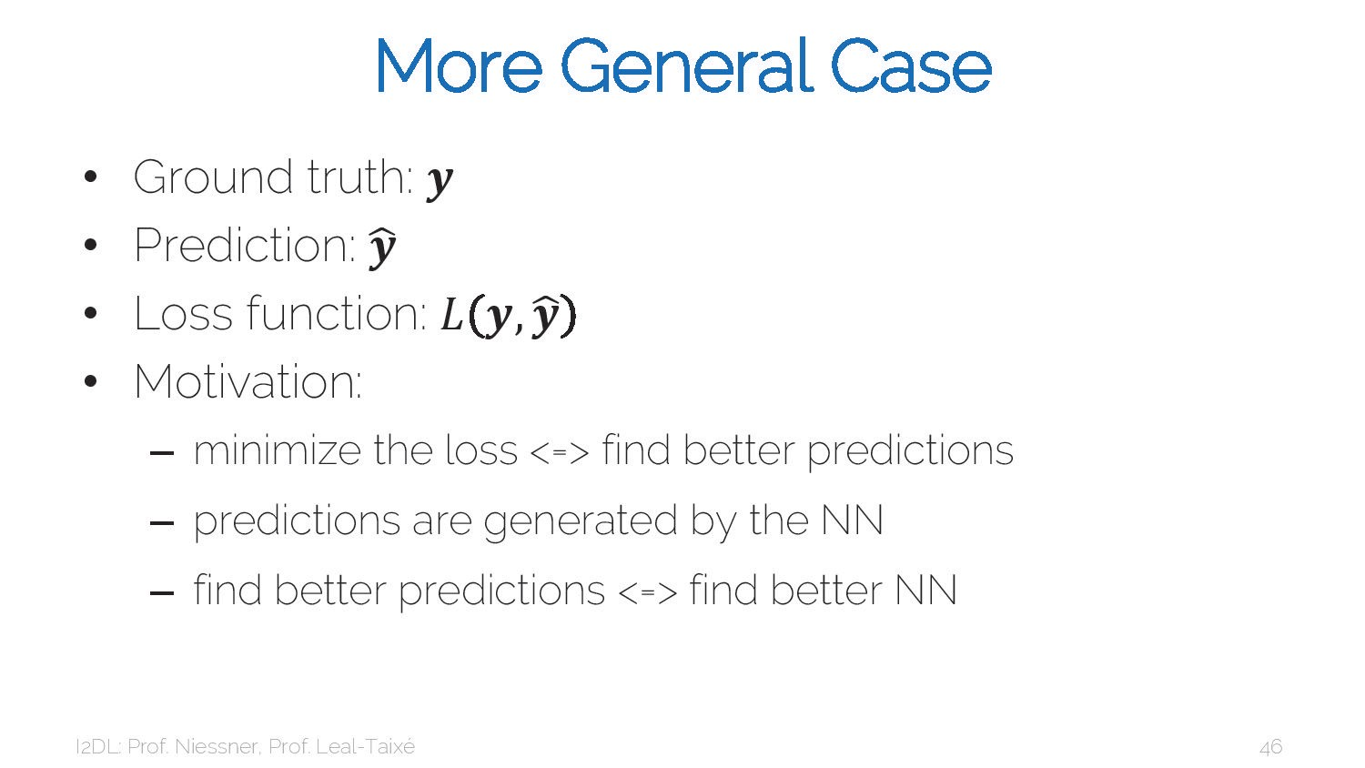
24

Slide 25
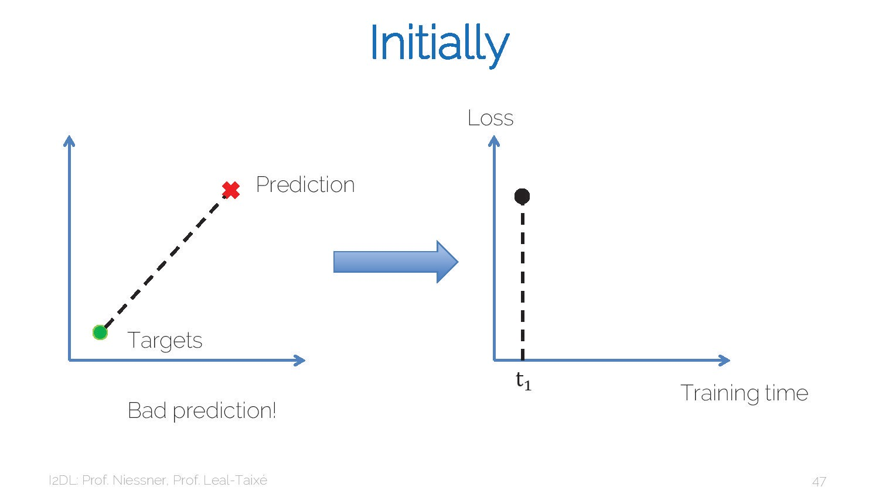
25

Slide 26
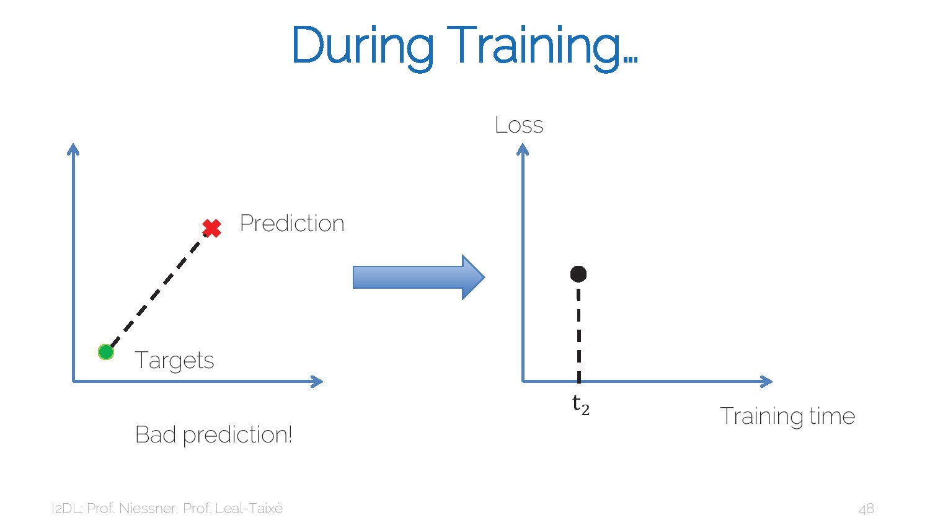
26

Slide 27
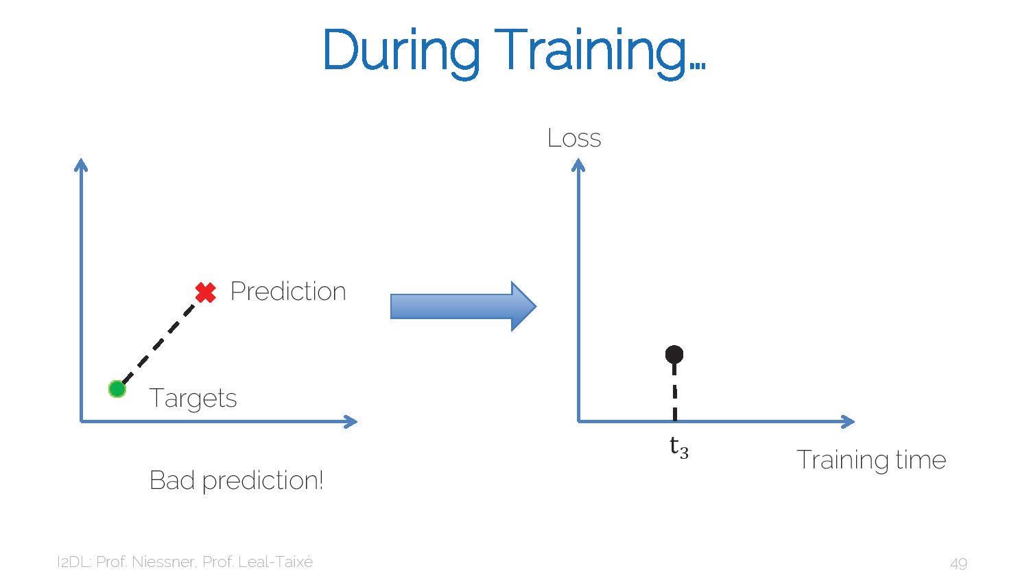
27

Slide 28
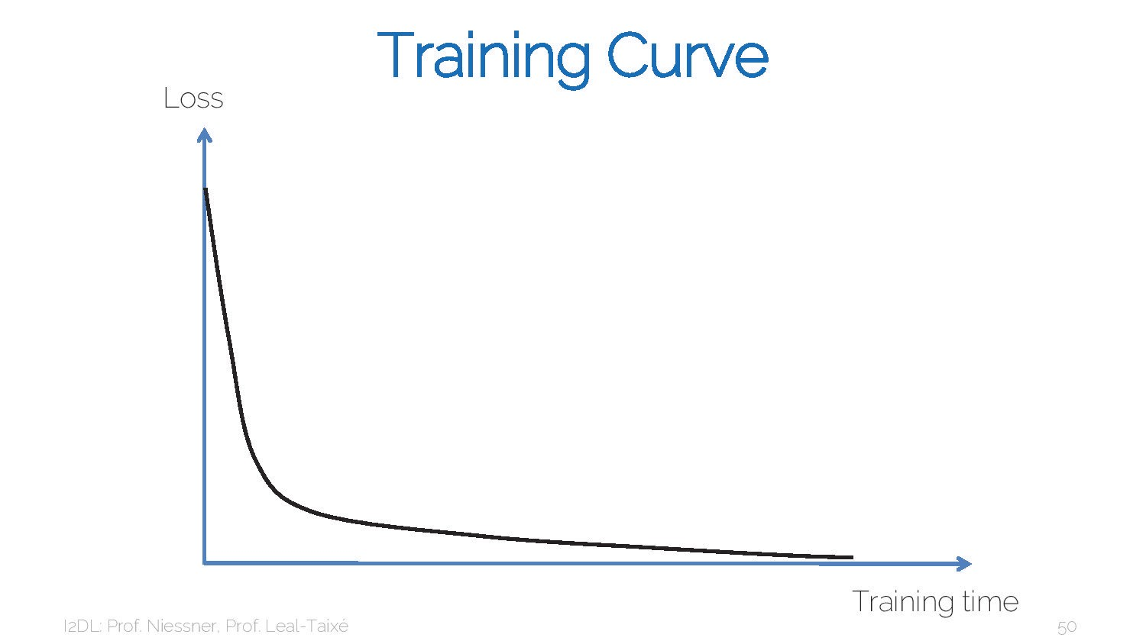
28

Slide 29
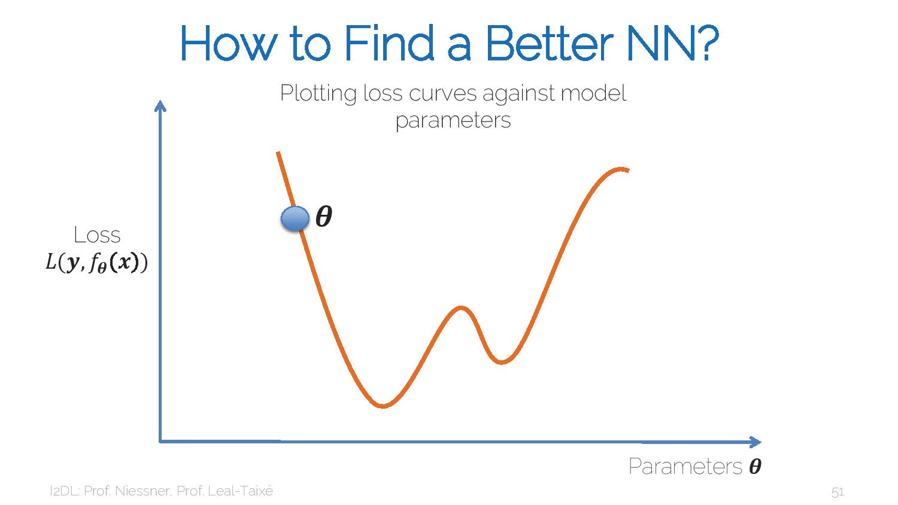
29

Slide 30
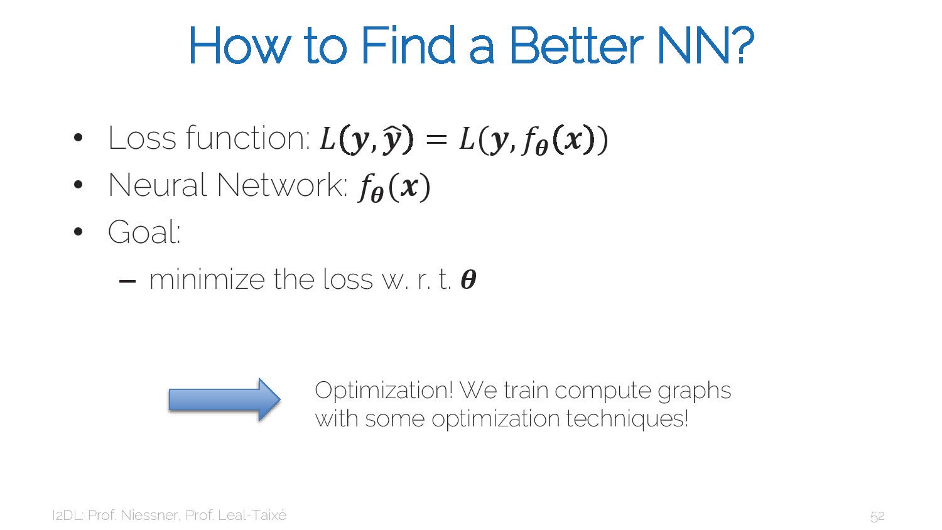
30

Slide 31
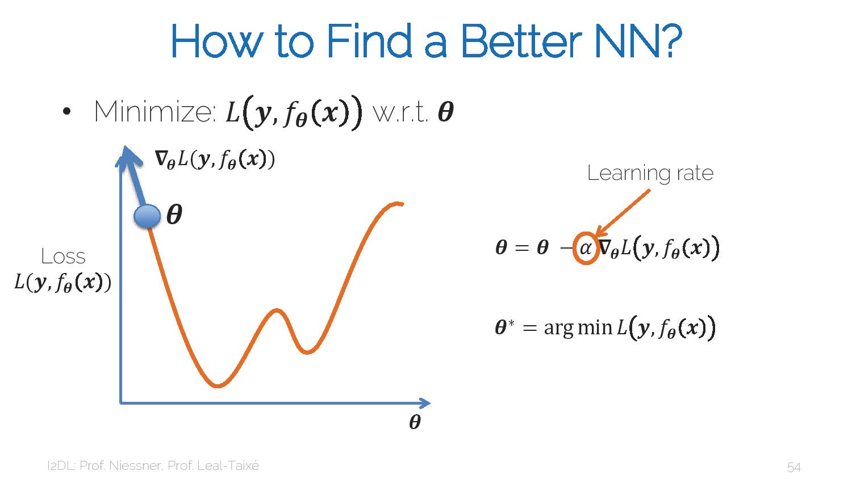
31

Slide 32
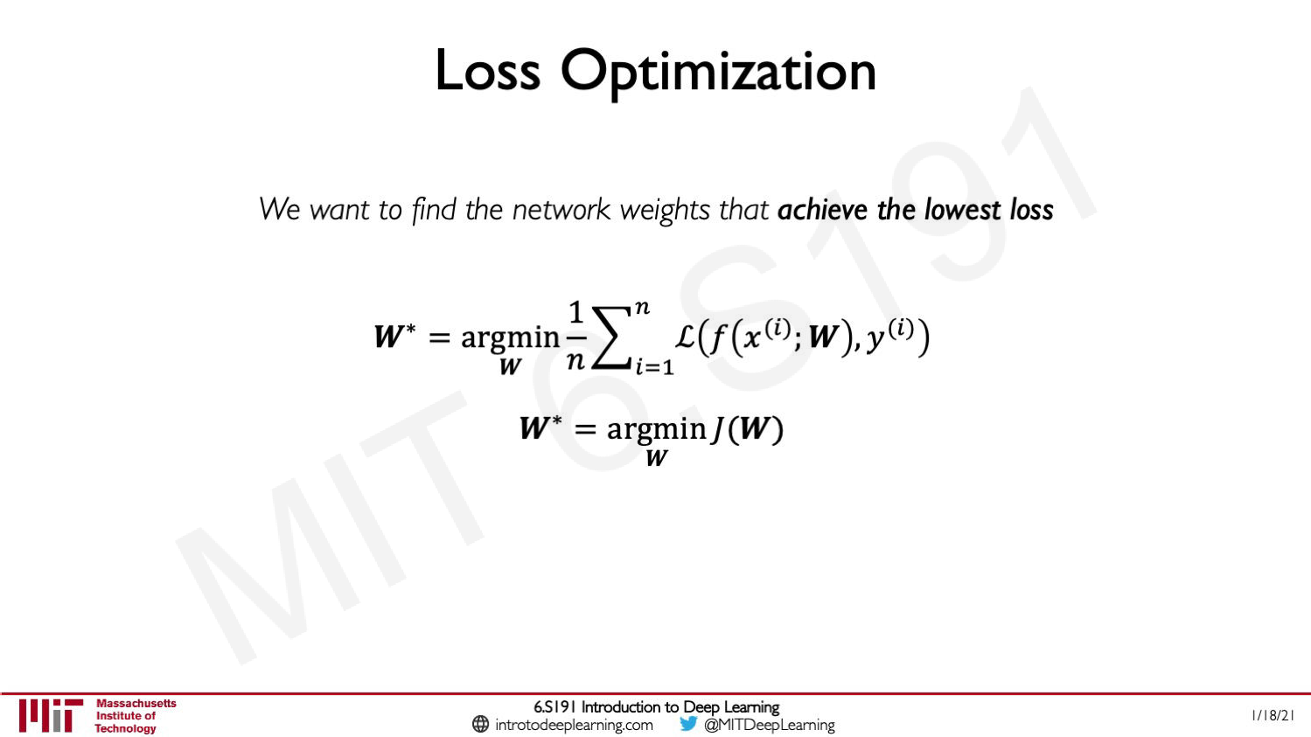
32

Slide 33
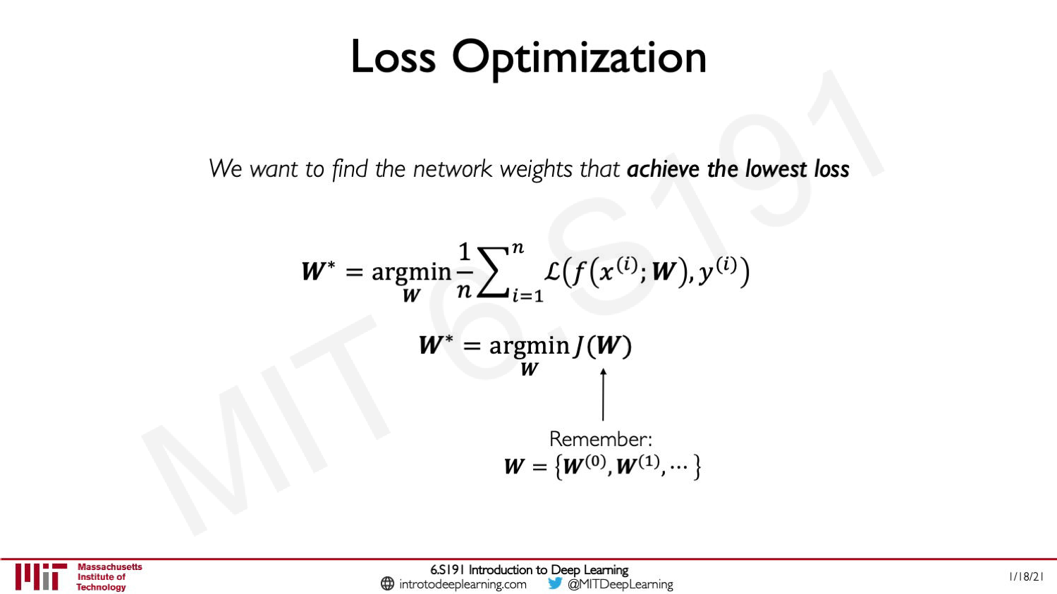
33

Slide 34
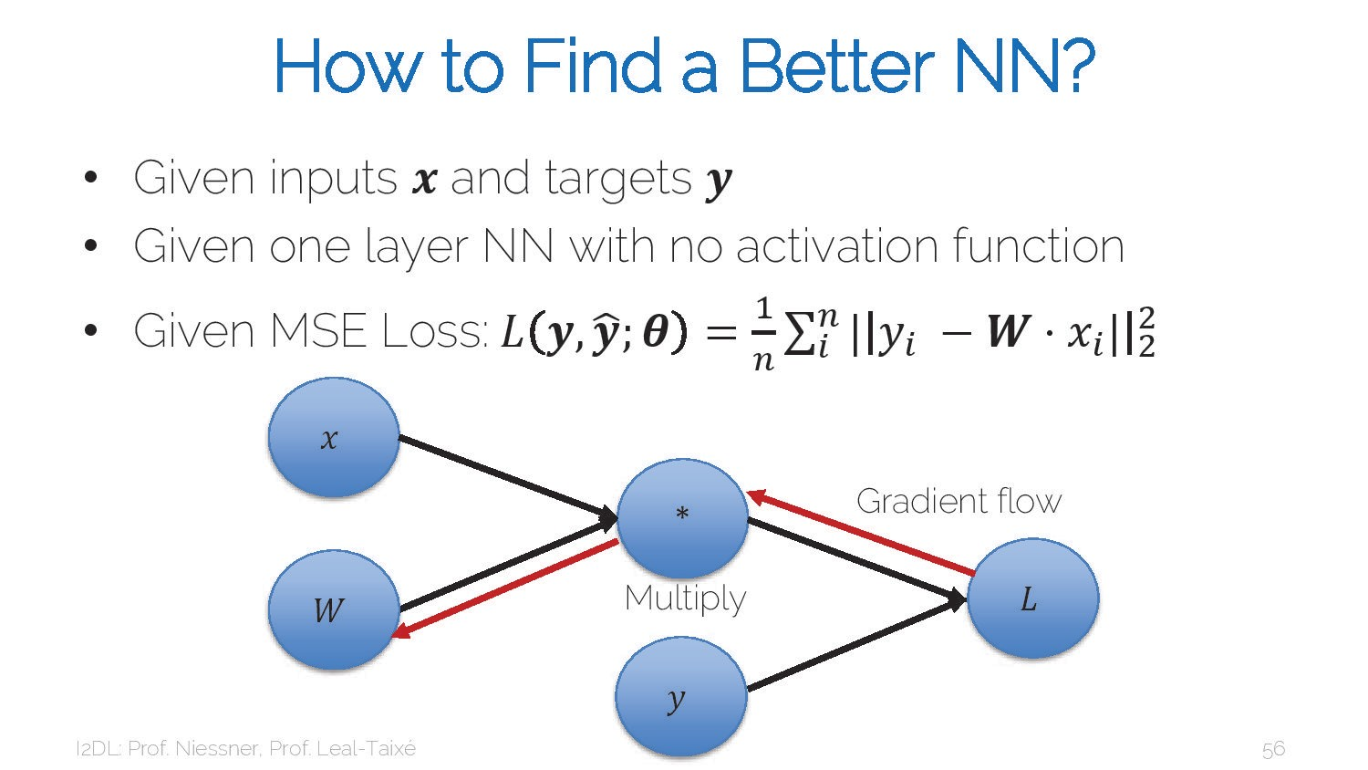
34

Slide 35
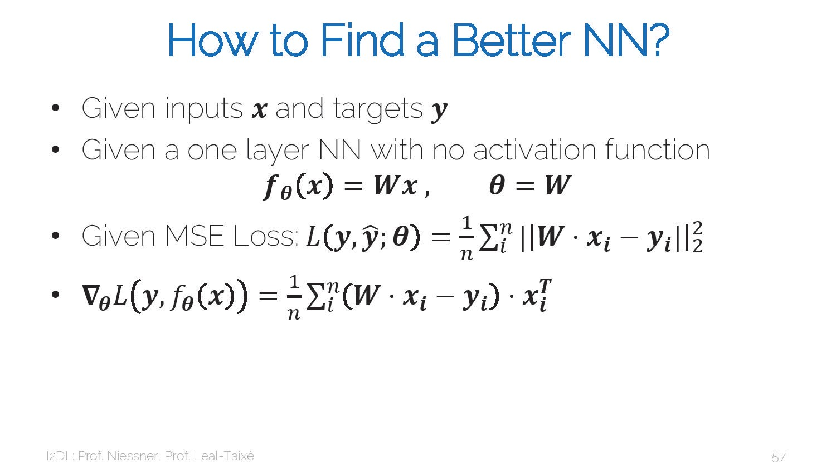
35

Slide 36
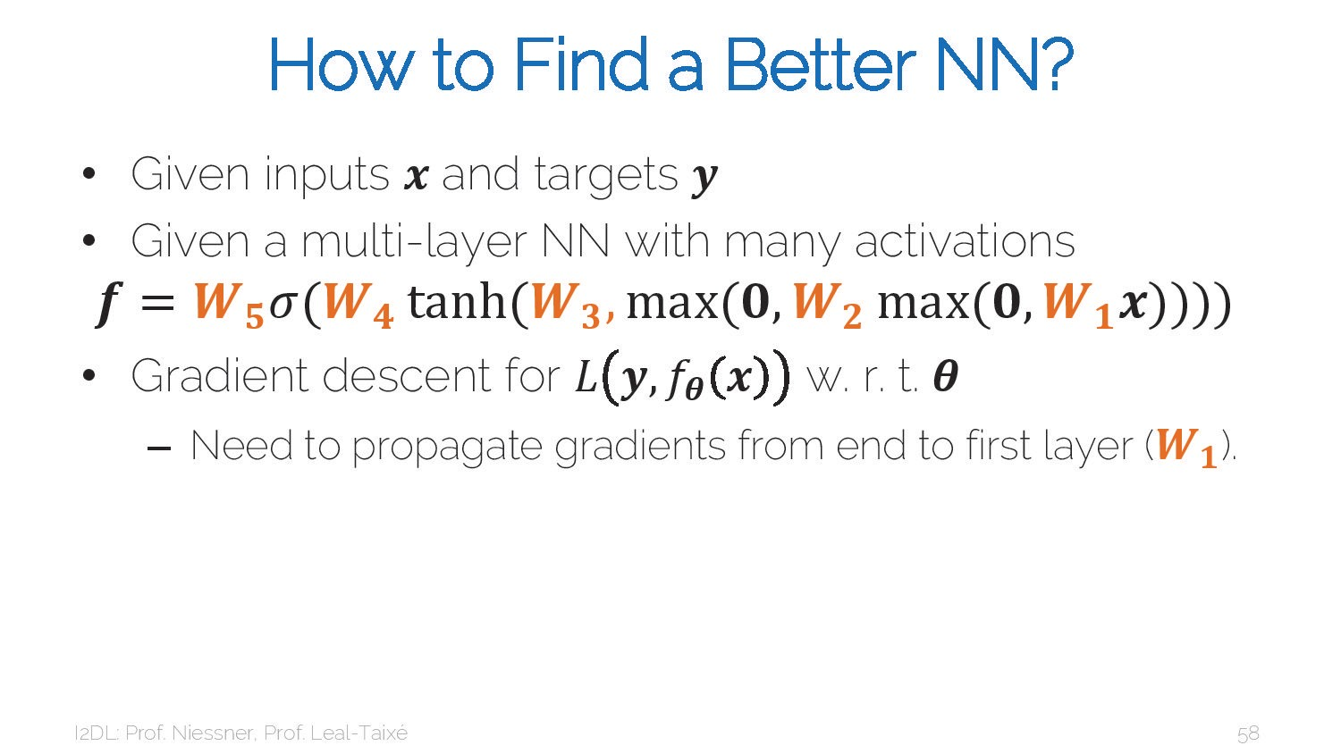
36

Slide 37
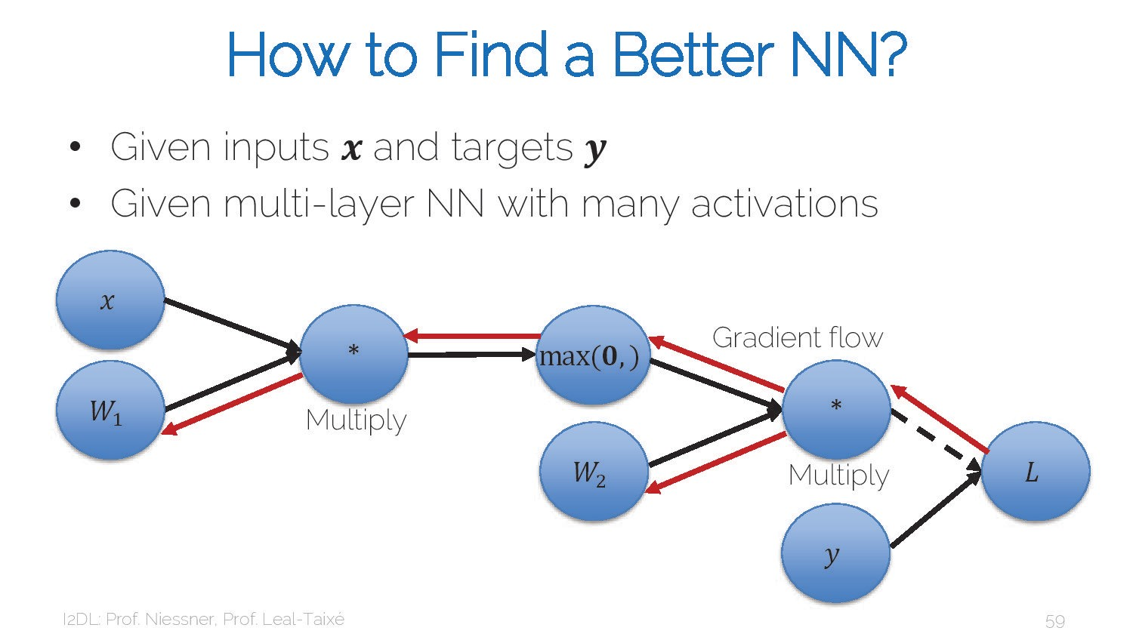
37

Slide 38
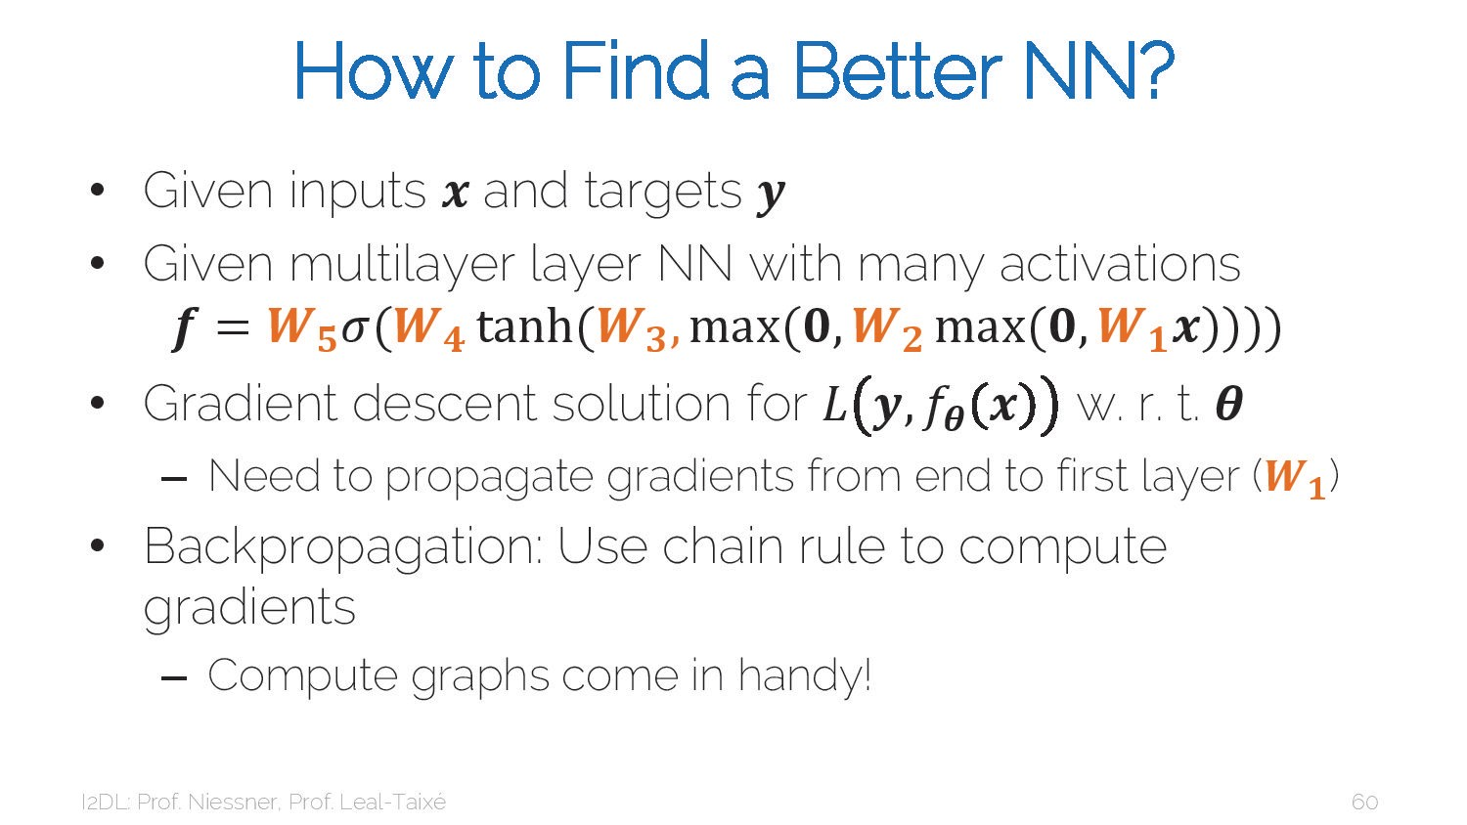

Slide 39
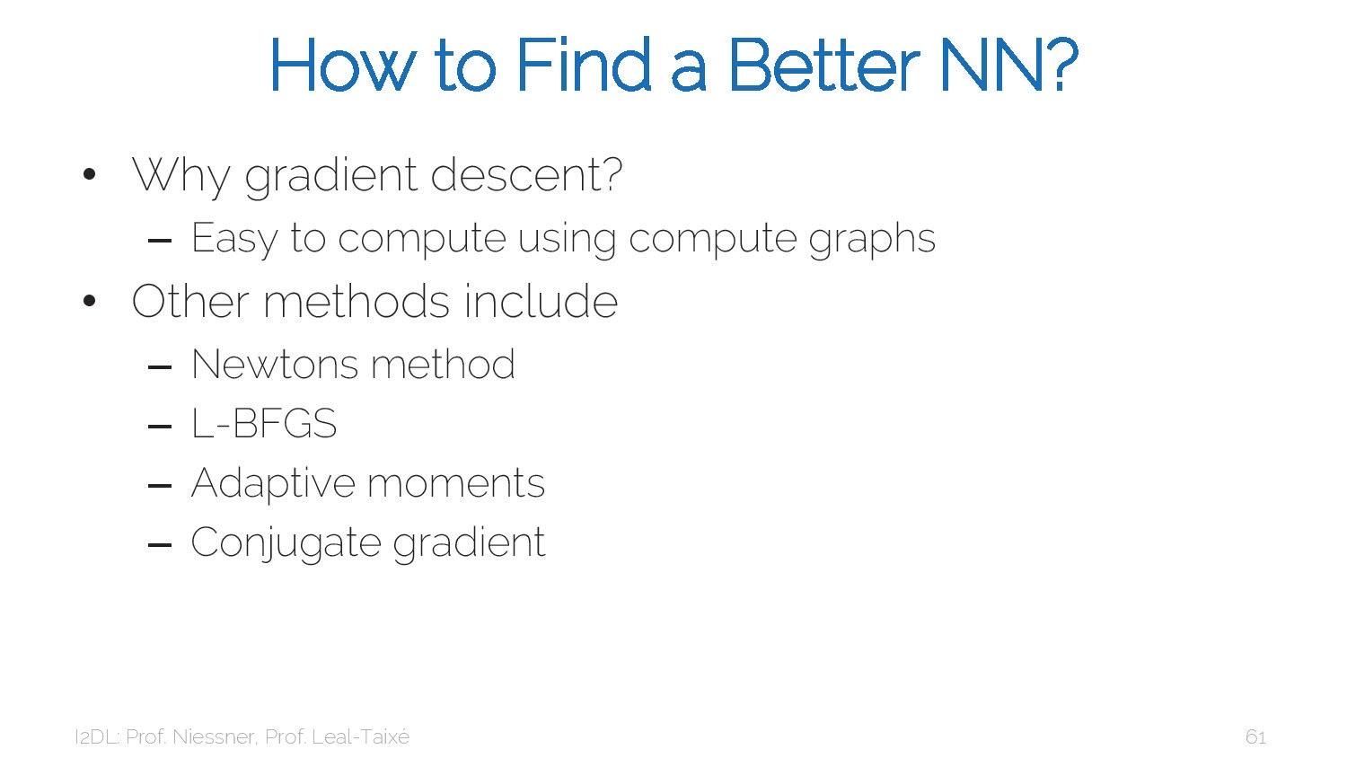

Slide 40
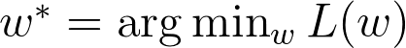
Optimization

Slide 41
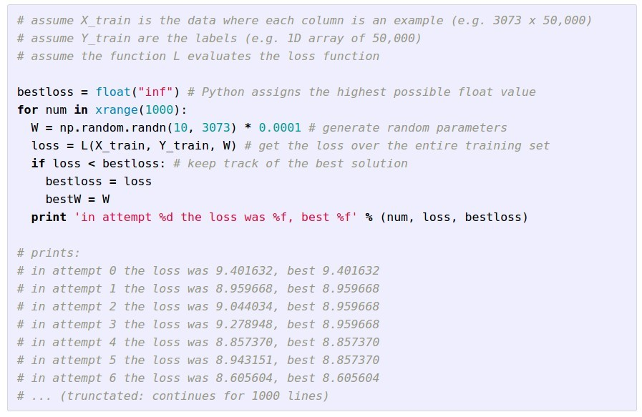
Idea #1: Random Search (bad idea!)

Slide 42
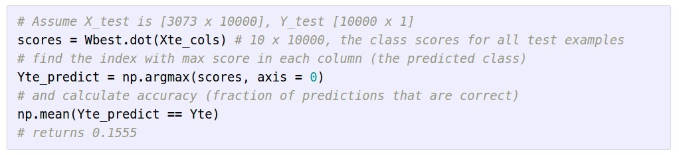
Idea #1: Random Search (bad idea!)
15.5% accuracy! not bad!

Slide 43
Idea #1: Random Search (bad idea!)
15.5% accuracy! not bad! (SOTA is ~95%)

Slide 44


Slide 45
Idea #2: Follow the slope

Slide 46


Slide 47
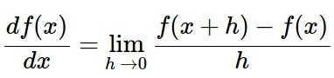
Idea #2: Follow the slope
In 1-dimension, the derivative of a function gives the slope:

Slide 48
Idea #2: Follow the slope
In 1-dimension, the derivative of a function gives the slope:
In multiple dimensions, the gradient is the vector of (partial derivatives) along each dimension
The slope in any direction is the dot product of the direction with the gradient The direction of steepest descent is the negative gradient

Slide 49
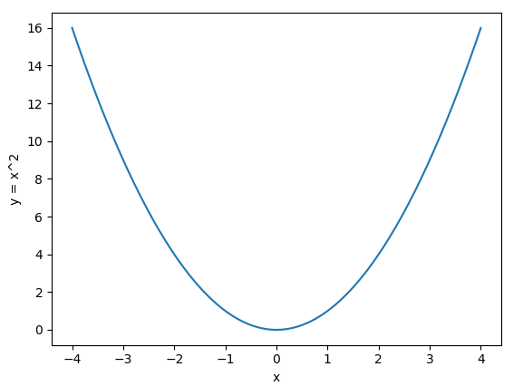
y=x^2
dy/dx=2∗xdy/dx=2∗x
1st quadrant -> gradient is positive, but if you use this as it is you move away from origin or minima. So, the negative sign helps here.
2nd quadrant -> gradient is negative, but if you use this as it is you move away from origin or minima(addition of two negative values). So, the negative sign helps here.

Slide 50
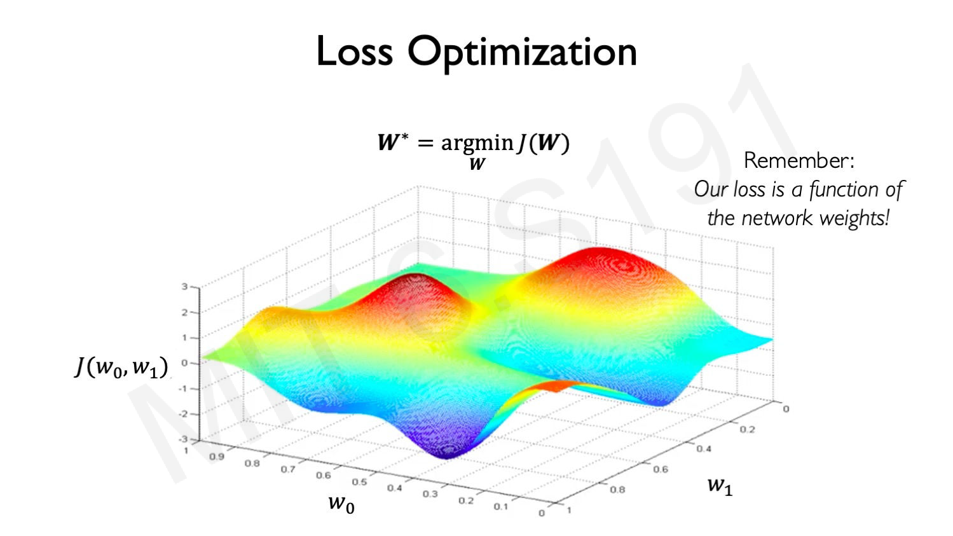
50

Slide 51
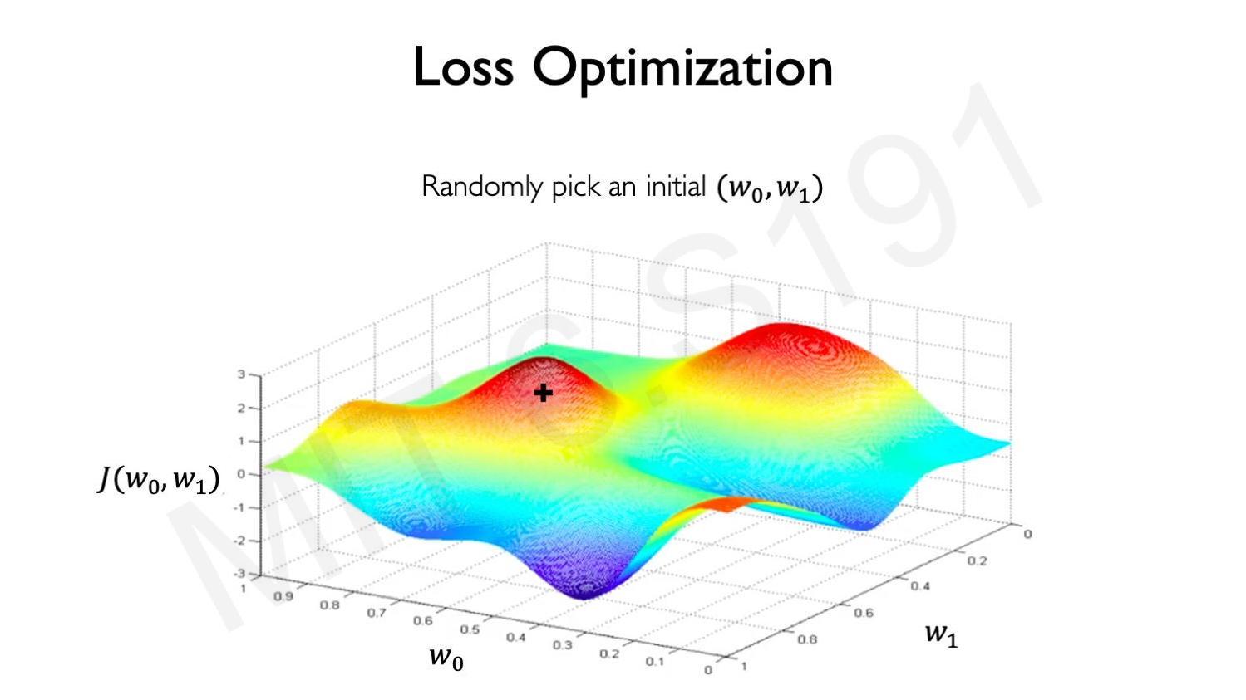
51

Slide 52

52

Slide 53

53

Slide 54

54

Slide 55

55

Slide 56

56

Slide 57

57

Slide 58
current W:
gradient dL/dW:
[0.34,
-1.11,
0.78,
0.12,
0.55,
2.81,
-3.1,
-1.5,
0.33,…]
loss 1.25347
[?,
?,
?,
?,
?,
?,
?,
?,
?,…]

Slide 59
current W:
W + h (first dim):
gradient dL/dW:
[0.34,
-1.11,
0.78,
0.12,
0.55,
2.81,
-3.1,
-1.5,
0.33,…]
loss 1.25347
[0.34 + 0.0001,
-1.11,
0.78,
0.12,
0.55,
2.81,
-3.1,
-1.5,
0.33,…]
loss 1.25322
[?,
?,
?,
?,
?,
?,
?,
?,
?,…]

Slide 60
current W:
W + h (first dim):
gradient dL/dW:
[0.34,
-1.11,
0.78,
0.12,
0.55,
2.81,
-3.1,
-1.5,
0.33,…]
loss 1.25347
[0.34 + 0.0001,
-1.11,
0.78,
0.12,
0.55,
2.81,
-3.1,
-1.5,
0.33,…]
loss 1.25322
[-2.5,
?,
?,
(1.25322 - 1.25347)/0.0001
= -2.5
?,
?,…]

Slide 61
current W:
W + h (second dim):
gradient dL/dW:
[0.34,
-1.11,
0.78,
0.12,
0.55,
2.81,
-3.1,
-1.5,
0.33,…]
loss 1.25347
[0.34,
-1.11 + 0.0001,
0.78,
0.12,
0.55,
2.81,
-3.1,
-1.5,
0.33,…]
loss 1.25353
[-2.5,
?,
?,
?,
?,
?,
?,
?,
?,…]

Slide 62
current W:
W + h (second dim):
gradient dL/dW:
[-2.5,
0.6,
?,
?,
(1.25353 - 1.25347)/0.0001
= 0.6
?,…]
[0.34,
-1.11,
0.78,
0.12,
0.55,
2.81,
-3.1,
-1.5,
0.33,…]
loss 1.25347
[0.34,
-1.11 + 0.0001,
0.78,
0.12,
0.55,
2.81,
-3.1,
-1.5,
0.33,…]
loss 1.25353

Slide 63
current W:
W + h (third dim):
gradient dL/dW:
[0.34,
-1.11,
0.78,
0.12,
0.55,
2.81,
-3.1,
-1.5,
0.33,…]
loss 1.25347
[0.34,
-1.11,
0.78 + 0.0001,
0.12,
0.55,
2.81,
-3.1,
-1.5,
0.33,…]
loss 1.25347
[-2.5,
0.6,
?,
?,
?,
?,
?,
?,
?,…]

Slide 64
current W:
W + h (third dim):
gradient dL/dW:
[0.34,
-1.11,
0.78,
0.12,
0.55,
2.81,
-3.1,
-1.5,
0.33,…]
loss 1.25347
[0.34,
-1.11,
0.78 + 0.0001,
0.12,
0.55,
2.81,
-3.1,
-1.5,
0.33,…]
loss 1.25347
[-2.5,
0.6,
0.0,
?,
?,
?,
?,
?,
?,…]
(1.25347 - 1.25347)/0.0001
= 0.0

Slide 65
current W:
W + h (third dim):
gradient dL/dW:
[0.34,
-1.11,
0.78,
0.12,
0.55,
2.81,
-3.1,
-1.5,
0.33,…]
loss 1.25347
[0.34,
-1.11,
0.78 + 0.0001,
0.12,
0.55,
2.81,
-3.1,
-1.5,
0.33,…]
loss 1.25347
[-2.5,
0.6,
0.0,
?,
?,
?,
?,
?,
?,…]
Numeric Gradient:
Slow: O(#dimensions)
Approximate

Slide 66


Loss is a function of W
want

Slide 67


Loss is a function of W: Analytic Gradient
want
Use calculus to compute an
analytic gradient
This image is in the public domain
This image is in the public domain

Slide 68
current W:
gradient dL/dW:
[0.34,
-1.11,
0.78,
0.12,
0.55,
2.81,
-3.1,
-1.5,
0.33,…]
loss 1.25347
[-2.5,
0.6,
0,
0.2,
0.7,
-0.5,
1.1,
1.3,
-2.1,…]
dL/dW = ... (some function data and W)

Slide 69
current W:
gradient dL/dW:
[0.34,
-1.11,
0.78,
0.12,
0.55,
2.81,
-3.1,
-1.5,
0.33,…]
loss 1.25347
[-2.5,
0.6,
0,
0.2,
0.7,
-0.5,
1.1,
1.3,
-2.1,…]
dL/dW = ... (some function data and W)
(In practice we will compute dL/dW using backpropagation; see Lecture 6)

Slide 70
Computing Gradients
Numeric gradient: approximate, slow, easy to write
Analytic gradient: exact, fast, error-prone
In practice: Always use analytic gradient, but check implementation with numerical gradient. This is called a gradient check.

Slide 71

Computing Gradients
Numeric gradient: approximate, slow, easy to write
Analytic gradient: exact, fast, error-prone
In practice: Always use analytic gradient, but check implementation with numerical gradient. This is called a gradient check.

Slide 72

Computing Gradients
Numeric gradient: approximate, slow, easy to write
Analytic gradient: exact, fast, error-prone
In practice: Always use analytic gradient, but check implementation with numerical gradient. This is called a gradient check.

Slide 73

Computing Gradients
Numeric gradient: approximate, slow, easy to write
Analytic gradient: exact, fast, error-prone
In practice: Always use analytic gradient, but check implementation with numerical gradient. This is called a gradient check.

Slide 74

Gradient Descent
Iteratively step in the direction of the negative gradient
(direction of local steepest descent)
Hyperparameters:
Weight initialization method
Number of steps
Learning rate

Slide 75

75

Slide 76

76

Slide 77

77

Slide 78

78

Slide 79

79

Slide 80

80

Slide 81

81

Slide 82

82

Slide 83

83

Slide 84

84

Slide 85

85

Slide 86

86

Slide 87

negative gradient direction
Gradient Descent
Iteratively step in the direction of the negative gradient
(direction of local steepest descent)
original W
W_2
Hyperparameters:
Weight initialization method
Number of steps
Learning rate
W_1

Slide 88

Gradient Descent
Iteratively step in the direction of the negative gradient
(direction of local steepest descent)
Hyperparameters:
Weight initialization method
Number of steps
Learning rate

Slide 89


Batch Gradient Descent
Full sum expensive when N is large!

Slide 90

90

Slide 91

91

Slide 92

92

Slide 93

93

Slide 94

94

Slide 95

95

Slide 96

96

Slide 97

97

Slide 98

98

Slide 99

Stochastic Gradient Descent (SGD)
Full sum expensive when N is large!
Approximate sum using a minibatch of examples 32 / 64 / 128 common
Hyperparameters:
Weight initialization
Number of steps
Learning rate
Batch size
Data sampling

Slide 100
Stochastic Gradient Descent (SGD)
Think of loss as an expectation over the full data distribution p_{data}
Approximate expectation via sampling

Slide 101
Stochastic Gradient Descent (SGD)
Think of loss as an expectation over the full data distribution p_{data}
Approximate expectation via sampling

Slide 102

Interactive Web Demo
http://vision.stanford.edu/teaching/cs231n-demos/linear-classify/

Slide 103
Problems with SGD
What if loss changes quickly in one direction and slowly in another? What does gradient descent do?
Loss function has high condition number: ratio of largest to smallest singular value of the Hessian matrix is large

Slide 104
Problems with SGD
What if loss changes quickly in one direction and slowly in another? What does gradient descent do?
Very slow progress along shallow dimension, jitter along steep direction
Loss function has high condition number: ratio of largest to smallest singular value of the Hessian matrix is large

Slide 105

Problems with SGD
Local Minimum
What if the loss function has a local minimum or saddle point?
Saddle point

Slide 106
Problems with SGD
Local Minimum
What if the loss function has a local minimum or saddle point?
Saddle point
Zero gradient, gradient descent gets stuck

Slide 107



Problems with SGD
Our gradients come from minibatches so they can be noisy!

Slide 108


SGD
SGD

Slide 109


SGD + Momentum
SGD
SGD+Momentum
Build up “velocity” as a running mean of gradients
Rho gives “friction”; typically rho=0.9 or 0.99

Slide 110


SGD + Momentum
SGD+Momentum
SGD+Momentum
You may see SGD+Momentum formulated different ways, but they are equivalent - give same sequence of x

Slide 111

Gradient Noise
SGD + Momentum
Local Minima
Saddle points
Poor Conditioning
SGD
SGD+Momentum
Sutskever et al, “On the importance of initialization and momentum in deep learning”, ICML 2013

Slide 112
SGD + Momentum
Momentum update:
Velocity
actual step
Gradient
Combine gradient at current point with velocity to get step used to update weights
Nesterov, “A method of solving a convex programming problem with convergence rate O(1/k^2)”, 1983 Nesterov, “Introductory lectures on convex optimization: a basic course”, 2004
Sutskever et al, “On the importance of initialization and momentum in deep learning”, ICML 2013

Slide 113
Nesterov Momentum
Momentum update:
Velocity
actual step
Nesterov Momentum
Gradient actual step
Velocity
Gradient
Combine gradient at current point with velocity to get step used to update weights
Nesterov, “A method of solving a convex programming problem with convergence rate O(1/k^2)”, 1983 Nesterov, “Introductory lectures on convex optimization: a basic course”, 2004
“Look ahead” to the point where updating using velocity would take us; compute gradient there and mix it with velocity to get actual update direction
Sutskever et al, “On the importance of initialization and momentum in deep learning”, ICML 2013

Slide 114

Nesterov Momentum
Gradient
Velocity
actual step
“Look ahead” to the point where updating using velocity would take us; compute gradient there and mix it with velocity to get actual update direction

Slide 115

Nesterov Momentum
Annoying, usually we want update in terms of
Gradient
Velocity
actual step
“Look ahead” to the point where updating using velocity would take us; compute gradient there and mix it with velocity to get actual update direction

Slide 116



Nesterov Momentum
Annoying, usually we want update in terms of
Change of variables and rearrange:

Slide 117

Nesterov Momentum
SGD
SGD+Momentum Nesterov

Slide 118

AdaGrad
Added element-wise scaling of the gradient based on the historical sum of squares in each dimension
“Per-parameter learning rates” or “adaptive learning rates”
Duchi et al, “Adaptive subgradient methods for online learning and stochastic optimization”, JMLR 2011

Slide 119
AdaGrad

Slide 120
Q: What happens with AdaGrad?

Slide 121
AdaGrad
Progress along “steep” directions is damped; progress along “flat” directions is accelerated
Q: What happens with AdaGrad?

Slide 122

RMSProp: “Leak Adagrad”
AdaGrad
RMSProp
Tieleman and Hinton, 2012

Slide 123

RMSProp
SGD
SGD+Momentum RMSProp

Slide 124

Adam (almost): RMSProp + Momentum

Slide 125

Adam (almost): RMSProp + Momentum
Adam
Momentum
SGD+Momentum

Slide 126
Adam (almost): RMSProp + Momentum
Adam
Momentum AdaGrad / RMSProp
RMSProp

Slide 127
Adam (almost): RMSProp + Momentum
Adam
Momentum AdaGrad / RMSProp
Bias correction
Q: What happens at t=0? (Assume beta2 = 0.999)

Slide 128

Adam (almost): RMSProp + Momentum
Momentum AdaGrad / RMSProp
Bias correction
Bias correction for the fact that first and second moment estimates start at zero

Slide 129
Adam (almost): RMSProp + Momentum
Bias correction for the fact that first and second moment estimates start at zero
Adam with beta1 = 0.9,
beta2 = 0.999, and learning_rate = 1e-3, 5e-4, 1e-4 is a great starting point for many models!

Slide 130




Adam: Very Common in Practice!
Johnson, Gupta, and Fei-Fei, CVPR 2018
Bakhtin, van der Maaten, Johnson, Gustafson, and Girshick, NeurIPS 2019
Gkioxari, Malik, and Johnson, ICCV 2019
Zhu, Kaplan, Johnson, and Fei-Fei, ECCV 2018
Gupta, Johnson, et al, CVPR 2018
Adam with beta1 = 0.9,
beta2 = 0.999, and learning_rate = 1e-3, 5e-4, 1e-4 is a great starting point for many models!

Slide 131

Adam
SGD
SGD+Momentum RMSProp
Adam

Slide 132
Optimization Algorithm Comparison
Algorithm | Tracks first moments (Momentum) | Tracks second moments (Adaptive learning rates) | Leaky second moments | Bias correction for moment estimates
SGD | 𝙭 | 𝙭 | 𝙭 | 𝙭
SGD+Momentum | ✓ | 𝙭 | 𝙭 | 𝙭
Nesterov | ✓ | 𝙭 | 𝙭 | 𝙭
AdaGrad | 𝙭 | ✓ | 𝙭 | 𝙭
RMSProp | 𝙭 | ✓ | ✓ | 𝙭
Adam | ✓ | ✓ | ✓ | ✓

Slide 133
So far: First-Order Optimization
Loss
w1

Slide 134
So far: First-Order Optimization
1. Use gradient to make linear approximation
2. Step to minimize the approximation
Loss
w1

Slide 135
Second-Order Optimization
1. Use gradient and Hessian to make quadratic approximation
2. Step to minimize the approximation
Loss
w1

Slide 136
Second-Order Optimization
1. Use gradient and Hessian to make quadratic approximation
2. Step to minimize the approximation
Loss
Take bigger steps in areas of low curvature
w1

Slide 137
Second-Order Optimization
Second-Order Taylor Expansion:
Solving for the critical point we obtain the Newton parameter update:

Slide 138
Second-Order Optimization
Second-Order Taylor Expansion:
Solving for the critical point we obtain the Newton parameter update:
Q: Why is this impractical?

Slide 139
Second-Order Optimization
Second-Order Taylor Expansion:
Solving for the critical point we obtain the Newton parameter update:
Hessian has O(N^2) elements Inverting takes O(N^3)
N = (Tens or Hundreds of) Millions
Q: Why is this impractical?

Slide 140
Second-Order Optimization
Quasi-Newton methods (BGFS most popular):
instead of inverting the Hessian (O(n^3)), approximate inverse Hessian with rank 1 updates over time (O(n^2) each).
L-BFGS (Limited memory BFGS):
Does not form/store the full inverse Hessian.

Slide 141
Second-Order Optimization: L-BFGS
- Usually works very well in full batch, deterministic mode
i.e. if you have a single, deterministic f(x) then L-BFGS will probably work very nicely
- Does not transfer very well to mini-batch setting. Gives bad results. Adapting second-order methods to large-scale, stochastic setting is an active area of research.

Slide 142
In practice:
Adam is a good default choice in many cases SGD+Momentum can outperform Adam but may require more tuning
If you can afford to do full batch updates then try out
L-BFGS (and don’t forget to disable all sources of noise)

Slide 143


Summary
Use Linear Models for image classification problems
Use Loss Functions to express preferences over different choices of weights
Use Stochastic Gradient Descent to minimize our loss functions and train the model
Softmax
SVM

